Slide 1
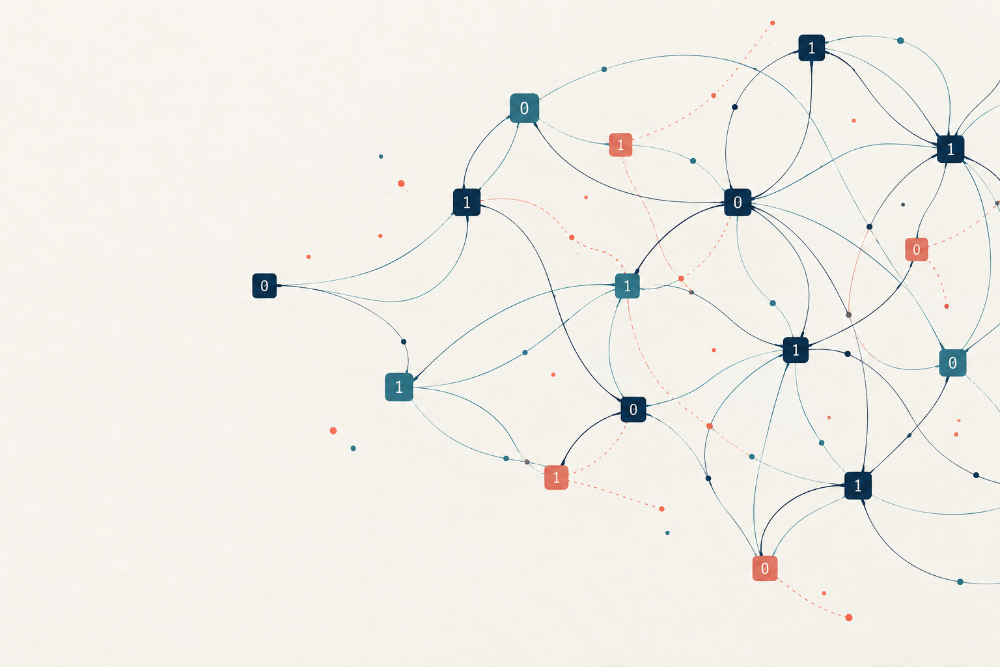
Average-case hardness
and the foundations
of public-key encryption
Understanding ABW’s opening claim
Definitions and worked examples
Research discussion · 6 October 2026
Average-case hardness and ABW
01
Notes:
A 15–20 minute conceptual presentation for cryptography colleagues. Slides 1–16 are the main talk and 17–20 are the appendix. Terminology: average-case hardness, also called hardness on average. The illustrations use deliberately small numbers and artificial distributions to explain definitions. They are not proposed cryptographic parameters. Assessment date: 6 October 2026.
Sources
https://www.math.ias.edu/~avi/PUBLICATIONS/MYPAPERS/ABW09/ABW09.pdf
https://www.cs.cornell.edu/courses/cs6830/2009fa/lecnotes.pdf

Slide 2
What does “broaden the foundations” mean?
A wider set of assumptions can support PKE.
Phrase | Meaning
Natural combinatorial problems | Local constraints and graphs, studied beyond cryptography
NP-hard optimization | Maximize satisfied equations with three variables each
New average-case assumptions | Difficulty under a specified random sampling rule
Worst-case optimization hardness alone does not establish cryptographic security.
Average-case hardness and ABW
02
Notes:
Interpretation of the sentence supplied by the user. ABW seeks additional assumption families for public-key encryption, involving local constraints and graph structure. The word new refers to the paper’s 2009/2010 context. The claim is a conditional construction result. Difference from existing assumptions does not establish greater security or efficiency.
Sources
https://www.math.ias.edu/~avi/PUBLICATIONS/MYPAPERS/ABW09/ABW09.pdf

Slide 3
Worst-case and average-case hardness
Worst-case viewpoint
Cryptographic viewpoint
Can one efficient algorithm
handle every valid instance?
Difficult inputs may occur rarely
under our sampling rule.
How often can an efficient attacker
succeed on generated instances?
The sampling distribution
forms part of the assumption.
Worst-case NP-hardness supplies no automatic success bound for the chosen sampler.
Average-case hardness and ABW
03
Notes:
Here average-case refers to cryptographic success probabilities under an instance distribution. General average-case complexity can also study expected running time, but that is not the only definition. NP-hardness is a worst-case reduction statement. Assuming an appropriate worst-case separation, it rules out a solver correct on every instance, without establishing a useful average-case success bound for a particular distribution.
Sources
https://www.cs.cornell.edu/courses/cs6830/2009fa/lecnotes.pdf
https://theory.cs.princeton.edu/complexity/book.pdf

Slide 4
Example 1: an easy distribution of SAT inputs
Artificial sampler
99%: obviously satisfiable
1%: general SAT formulas
Always answer “satisfiable”.
Success ≥ 99%
SAT remains NP-complete. This particular distribution is easy for the decision task.
Average-case hardness and ABW
04
Notes:
An original teaching example. With probability .99, the sampler outputs a trivially satisfiable formula of the desired size, such as x1 conjoined with padding tautologies. With probability .01 it outputs an arbitrary formula drawn from an efficiently sampleable general-formula distribution Q_n. The solver that always says satisfiable is correct with probability at least .99, regardless of its behaviour on Q_n. The general branch does not consist exclusively of hard or unsatisfiable inputs. The chart displays sampler branch mass, not measured hardness or exact classification success. SAT as a worst-case problem remains NP-complete.
Sources
https://www.cs.cornell.edu/courses/cs6830/2009fa/lecnotes.pdf
https://theory.cs.princeton.edu/complexity/book.pdf

Slide 5
Example 2: factoring depends on how inputs arise
Input generation | Small arithmetic example | What the attacker knows
N = 2p | 2 × 1009 = 2018 | 2 divides every generated input
N = pq, balanced primes | 1009 × 1013 = 1,022,117 | No factor is deliberately fixed
Both rows ask for factors.
Their generation rules create very different attack opportunities.
Both numerical examples are easy. Large-instance hardness requires an explicit assumption.
Average-case hardness and ABW
05
Notes:
An original distribution illustration inspired by standard factoring assumptions. An even product N=2p reveals a nontrivial factor immediately. Products of two independently sampled, distinct, similarly sized primes are a different distribution. Classical hardness for suitably large random semiprimes is conjectured; the small products shown are easy and only illustrate arithmetic. Factoring is not known to be NP-hard, and RSA inversion is not simply equivalent to factoring in general. The point is distribution dependence, not a hardness proof.
Sources
https://www.cs.cornell.edu/courses/cs6830/2009fa/lecnotes.pdf

Slide 6
Average success comes from a precise experiment
01
Generate an instance
The sampler chooses a public instance I and hidden witness w.
02
Run the attacker
A sees I and may use its own random coins.
03
Measure success
Repeat the experiment according to that same sampling law.
Average-case hardness and ABW
06
Notes:
For recovery of a planted secret, draw (I,w) from a defined efficient joint generator and supply only I to A. Average A’s success over the generator’s random choices and the adversary’s random coins. A general search problem may accept any valid witness; planted recovery specifically scores equality with the sampled w. The security parameter indexes an ensemble D_n rather than a single distribution. This deck later uses n for ABW’s number of variables. Do not confuse average success with expected running time.
Sources
https://www.cs.cornell.edu/courses/cs6830/2009fa/lecnotes.pdf

Slide 7
Success means different things for different tasks
Task | Required outcome | Blind baseline
Planted recovery | Output the exact sampled x | 2⁻ⁿ for uniform x
Valid-witness search | Output any acceptable witness | Depends on the relation
Balanced distinguishing | Identify which distribution generated I | 1/2
Optimization | Meet the specified objective or approximation | Depends on the problem
The task and the success threshold belong in every hardness assumption.
Average-case hardness and ABW
07
Notes:
The first row is the probability for a blind independent guess of a uniformly sampled n-bit secret, not a claim about posterior information after observations. A general search verifier may accept any valid witness. A balanced distinguishing game chooses one of two distributions with probability 1/2 each, so blind guessing succeeds with probability 1/2. In an unbalanced classification dataset, always guessing the more common class can succeed much more often without learning anything. Use advantage above an appropriate baseline and specify its normalization.
Sources
https://www.cs.cornell.edu/courses/cs6830/2009fa/lecnotes.pdf
https://www.math.ias.edu/~avi/PUBLICATIONS/MYPAPERS/ABW09/ABW09.pdf

Slide 8
Generating an instance can be easy
Generation
Recovery challenge
Sample x
Compute y = f(x)
Given y
Find a preimage
Easy forward computation can coexist
with conjectured average-case inversion difficulty.
Average-case hardness and ABW
08
Notes:
An original pedagogical description. Sampling a witness first and then computing its image can be easy, while recovering a preimage from the image can be conjecturally difficult. Factoring illustrates this with sampled primes and their product. For general one-way functions, recovering any preimage suffices, not necessarily the exact sampled x. This generation idea alone does not construct a public-key encryption scheme. In ABW’s ciphertext equations, x is fresh encryption randomness rather than the long-term decryption key.
Sources
https://www.cs.cornell.edu/courses/cs6830/2009fa/lecnotes.pdf

Slide 9
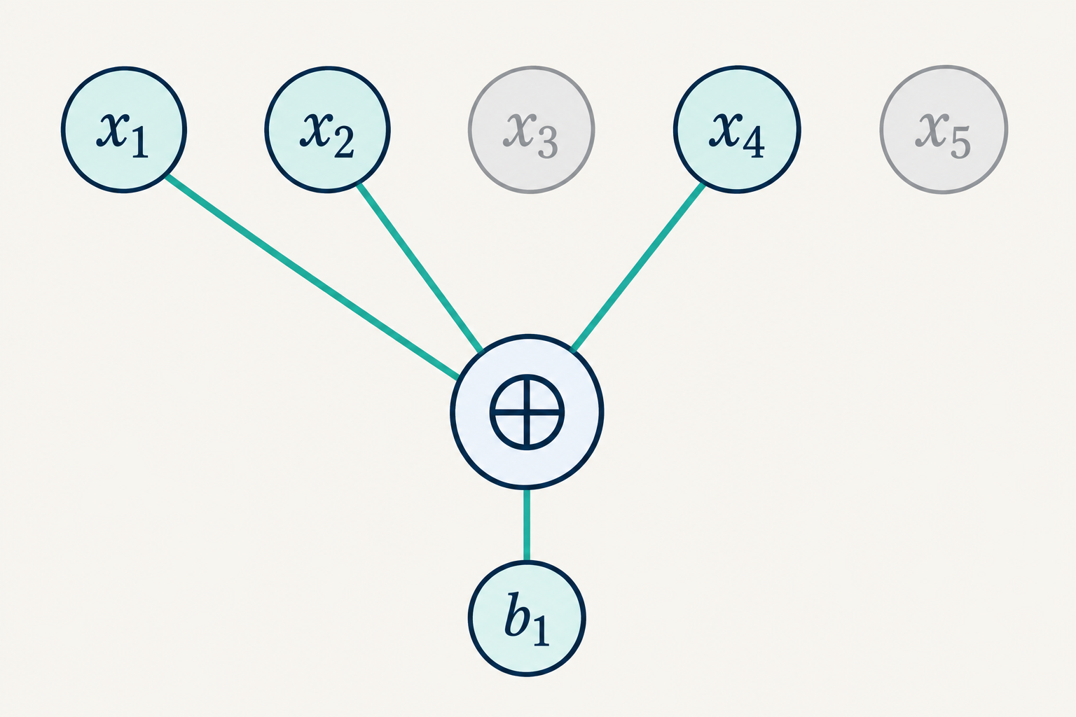
ABW’s sparse noisy-equation experiment
b = Mx + e
M: random rows of weight d
x: a uniform binary assignment
eᵢ: independent output flips
Attacker observes M and b.
Arithmetic is mod 2 (XOR). The sampling rule specifies n, m, d and ε.
Average-case hardness and ABW
09
Notes:
Independently sample each row of M uniformly among binary vectors with exactly d ones. Sample x uniformly and noise entries independently as Ber(epsilon), then set b=Mx+e. The adversary gets M and b. The picture shows the noiseless part of one row selecting x1,x2,x4. Changing locality, row distribution, sample count or noise changes the assumption.
Sources
https://www.math.ias.edu/~avi/PUBLICATIONS/MYPAPERS/ABW09/ABW09.pdf

Slide 10
Example 3: four noisy parity observations
x = (1, 0, 1, 1)ᵀ
Selected variables | Clean parity | Error bit | Observed bᵢ
x₁ ⊕ x₂ ⊕ x₃ | 0 | 0 | 0
x₁ ⊕ x₂ ⊕ x₄ | 0 | 1 | 1
x₁ ⊕ x₃ ⊕ x₄ | 1 | 0 | 1
x₂ ⊕ x₃ ⊕ x₄ | 0 | 0 | 0
This is one illustrative realization, with one flipped answer.
Average-case hardness and ABW
10
Notes:
Original finite-field example, not a hardness instance. Use x=(1,0,1,1)^T. The clean labels are (0,0,1,0)^T. Set e=(0,1,0,0)^T to illustrate one realized error, giving b=(0,1,1,0)^T. This is one chosen realization, not an assertion that Bernoulli noise always flips exactly one equation. Matrix rows select variables {1,2,3},{1,2,4},{1,3,4},{2,3,4}. All arithmetic uses XOR. The next slide shows a different assignment with an exact fit.
Sources
https://www.math.ias.edu/~avi/PUBLICATIONS/MYPAPERS/ABW09/ABW09.pdf

Slide 11
A perfect fit can miss the planted assignment
Sampled assignment
An exact fitting assignment
x = (1, 0, 1, 1)ᵀ
z = (0, 1, 1, 0)ᵀ
One observed equation fails.
Every observed equation holds.
Mz = b, but z ≠ x
Small algebraic example. A better observed fit need not identify the original hidden assignment.
Average-case hardness and ABW
11
Notes:
Original calculation using the prior slide. M is a full-rank 4 by 4 matrix over F2, so every label vector has a unique exact fit. For b=(0,1,1,0)^T, that fit is z=(0,1,1,0)^T. The sampled x=(1,0,1,1)^T violates one observed equation. Thus optimizing the observed fit does not automatically recover x. This deliberately underspecified small system is not in the ABW hardness regime, and it demonstrates why sample count and information-theoretic identifiability must be considered. Noiseless parity consistency and solving are polynomial-time tasks; noisy maximum satisfaction is a different task.
Sources
https://www.math.ias.edu/~avi/PUBLICATIONS/MYPAPERS/ABW09/ABW09.pdf

Slide 12
Expected noise is different from average hardness
Illustration: m = 20, ε = 0.10
Expected noise
E[W] = 2
Hardness on average
How often can an attacker
recover the hidden assignment?
Calculated distribution, showing 0–8 errors. E[W] = 2 does not mean every sample has two errors.
Average-case hardness and ABW
12
Notes:
Independent Bernoulli errors give W~Binomial(m,epsilon), E[W]=m epsilon. The calculated illustrative PMF uses m=20, epsilon=.1, displaying k=0 through 8. The omitted tail above 8 is small but nonzero. Expected noise of 2 is not a deterministic error count. Cryptographic average-case hardness instead concerns the success of every efficient attacker across generated instances, including all noise realizations and attacker randomness. This slide separates two uses of the word average.
Sources
https://www.math.ias.edu/~avi/PUBLICATIONS/MYPAPERS/ABW09/ABW09.pdf
https://www.cs.cornell.edu/courses/cs6830/2009fa/lecnotes.pdf

Slide 13
The precise ABW recovery assumption
s_A(n) = Pr[A(M, Mx + e) = x]
For every efficient randomized attacker A,
s_A(n) < 2/3 for all sufficiently large n.
d = 3 m = Θ(n¹·⁴) ε = Θ(n⁻⁰·²)
Suitable constants are essential. This statement is an assumption about a specific ensemble.
Average-case hardness and ABW
13
Notes:
ABW Definition 5.1 sets success below 2/3 for every PPT algorithm at sufficiently large n. Assumption 5.2 uses Search3LIN(C0 n^1.4,C1 n^-0.2), for every positive constants C0,C1; footnote 9 says the applications only need appropriate fixed universal constants. The theorem’s constants and all reduction losses matter. This is a weak constant-success hardness statement, not a claim that every recovery probability is negligible. Probability includes sampling M,x,e and the adversary’s coins. The single-assumption theorem is search-based.
Sources
https://www.math.ias.edu/~avi/PUBLICATIONS/MYPAPERS/ABW09/ABW09.pdf

Slide 14
What the construction theorem establishes
01
Assume a particular average-case problem is hard
The assumption fixes a distribution, task and parameter regime.
02
Construct encryption and analyse attacks
The reduction connects a scheme attack to the underlying problem.
03
Obtain conditional security
The guarantee holds if the assumptions and proof conditions hold.
Average-case hardness and ABW
14
Notes:
ABW gives conditional implications from selected combinations of assumptions to semantically secure PKE. An efficient attack on the constructed encryption would, through the analysed reduction chain, yield an algorithm conflicting with the selected assumption. Parameter and success losses must be accounted for. Restricted algorithm lower bounds support plausibility but do not prove general hardness. Key generation plants a secret decryption structure under a law whose relationship to the problem ensemble is itself analysed. The raw weak bit scheme also requires amplification.
Sources
https://www.math.ias.edu/~avi/PUBLICATIONS/MYPAPERS/ABW09/ABW09.pdf
https://crypto.ethz.ch/publications/files/HolRen05.pdf

Slide 15
Assumption, proof and evidence
Type of statement | What it tells us
Hardness assumption | No attacker in the stated class meets the success criterion
Security reduction | A scheme attack would give a relevant problem solver
Restricted lower bound | A particular computational model cannot succeed
Experimental evidence | Tested attacks behaved a certain way at tested sizes
The scope of the evidence determines the scope of the conclusion.
Average-case hardness and ABW
15
Notes:
Definitions rather than a chronology of the authors’ work. A hardness assumption is a conjectural computational statement. A reduction is a mathematical implication that can be proved while its premise remains conjectural. A benchmark or a lower bound for a restricted attack model gives evidence of a limited scope. No finite experiment exhausts all efficient algorithms. A novel attack can invalidate a proposed parameter set without refuting an asymptotic hardness assumption for all sufficiently large sizes.
Sources
https://www.math.ias.edu/~avi/PUBLICATIONS/MYPAPERS/ABW09/ABW09.pdf
https://www.cs.cornell.edu/courses/cs6830/2009fa/lecnotes.pdf

Slide 16
A complete hardness claim for our research
Required field | Question to answer
Distribution | Exactly how do we generate the public observations?
Task | Recover a planted secret, find a witness or distinguish?
Parameters | Which sizes, locality, sample count and noise rate?
Adversary | Which time, memory, sample access and quantum model?
Success bound | What probability or advantage do we rule out?
The problem together with its distribution and success criterion forms the foundation.
Average-case hardness and ABW
16
Notes:
Checklist drawn from the definitions developed in this presentation. Precisely name the input ensemble and distinguish the problem sampler from the planted public-key sampler. Fix success semantics and information available to the attacker. Specify n,m,d,epsilon and quantitative resource assumptions, classical or quantum. ABW’s asymptotic constant-success assumption alone does not calibrate a concrete 128-bit security estimate.
Sources

Slide 17
Appendix: weak and strong hardness
Strength | Example of a success condition | Interpretation
Weak search hardness | s_A(n) ≤ 1 − δ(n) δ(n) is noticeable | Every efficient A fails with a noticeable probability
Strong inversion hardness | s_A(n) is negligible | Every efficient A succeeds only rarely
ABW Search3LIN | s_A(n) < 2/3 eventually | A constant-threshold premise for its construction
Negligible ν(n): eventually ν(n) < 1/p(n)
for every positive polynomial p.
Technical appendix
17
Notes:
Simplified comparison for a specified search success event. A weak statement can bound failure away from zero for every efficient adversary, leaving high success possible. Strong one-wayness requires negligible inversion success. Negligible means eventually smaller than 1/p(n) for every positive polynomial p. ABW uses a constant success threshold for Search3LIN and a nontrivial reduction/amplification argument to obtain strong encryption security. Weak and strong one-way functions can be related through an appropriate amplification construction; arbitrary repetition is not automatically a proof for every primitive.
Sources
https://www.cs.cornell.edu/courses/cs6830/2009fa/lecnotes.pdf
https://www.math.ias.edu/~avi/PUBLICATIONS/MYPAPERS/ABW09/ABW09.pdf
https://crypto.ethz.ch/publications/files/HolRen05.pdf

Slide 18
Appendix: a balanced distinguishing game
P: (M, Mx + e) Q: (M, u)
Choose a hidden fair bit B.
Sample from P or Q according to B.
Ask the attacker to guess B.
Guessing advantage = |Pr[correct] − 1/2|
Here u is a uniform m-bit vector. Advantage conventions can differ by a factor of two.
Technical appendix
18
Notes:
Define P_n and Q_n as two input ensembles. Independently sample a fair hidden bit B, draw I from P_n for B=0 or Q_n for B=1, then let A guess B. This formulation measures |Pr[A(I)=B]-1/2|. ABW and many papers instead define distinguishing advantage as |Pr[A(P_n)=1]-Pr[A(Q_n)=1]|, which equals twice the guessing advantage for this experiment. Use one convention consistently. A biased class frequency is not evidence of cryptographic distinguishing power.
Sources
https://www.cs.cornell.edu/courses/cs6830/2009fa/lecnotes.pdf
https://www.math.ias.edu/~avi/PUBLICATIONS/MYPAPERS/ABW09/ABW09.pdf

Slide 19
Appendix: the worked example in matrix form
M
Mx = (0, 0, 1, 0)ᵀ
e = (0, 1, 0, 0)ᵀ
b = (0, 1, 1, 0)ᵀ
1 | 1 | 1 | 0
1 | 1 | 0 | 1
1 | 0 | 1 | 1
0 | 1 | 1 | 1
Mz = b
z = (0, 1, 1, 0)ᵀ
Every row has weight 3. These four equations do not constitute a secure parameter regime.
Technical appendix
19
Notes:
Original example. M=[[1,1,1,0],[1,1,0,1],[1,0,1,1],[0,1,1,1]], x=(1,0,1,1)^T, e=(0,1,0,0)^T. Mx=(0,0,1,0)^T, b=(0,1,1,0)^T. For z=(0,1,1,0)^T, Mz=b. The matrix is invertible over F2, so z is the unique exact fit for b. The example demonstrates fit versus planted recovery rather than computational hardness. The delta z+x=(1,1,0,1)^T satisfies M delta=e.
Sources

Slide 20
References and further reading
Applebaum, Barak & Wigderson (2009 / 2010)
Public-Key Cryptography from Different Assumptions
Introduction, Definition 5.1, Assumption 5.2 and Theorems 1–3
Pass & Shelat, A Course in Cryptography
Chapter 2: one-way functions, factoring and hardness amplification
Chapter 3: computational indistinguishability
Arora & Barak, Computational Complexity
Chapter 10: hard-on-average problems and one-way functions
Holenstein & Renner (2005)
Weak public-key encryption and security amplification
Technical appendix
20
Notes:
Primary sources for the material. The SAT mixture, factoring numbers, parity example and binomial chart are original teaching examples and calculated illustrations. Reference URLs also appear in relevant speaker notes. ABW’s source is the November 2009 manuscript; the conference version appeared at STOC 2010.
Sources
https://www.math.ias.edu/~avi/PUBLICATIONS/MYPAPERS/ABW09/ABW09.pdf
https://www.cs.cornell.edu/courses/cs6830/2009fa/lecnotes.pdf
https://theory.cs.princeton.edu/complexity/book.pdf
https://crypto.ethz.ch/publications/files/HolRen05.pdf

